Slide 1
FUNCTION, RECURTION and FUZZY SET
Session 13-14
Course : Z0184 - Discrete Mathematics
Effective Period : September 2017

Slide 2
These slides have been adapted from:
Susanna S.Epp. (2010). Discrete Mathematics with Applications.4th edition. Thomson Brooks/Cole. USA. ISBN: 9780534359454
Chapter 7
Acknowledgement

Slide 3
Learning Objectives
On successful completion of this Course, students will be able to:
LO 1: Explain the logic of compound and quantified statements and how do to proof
LO 2: Explain and applying Set Theory, Counting method and Number Theory
LO 3: Explain Function, recursion, fuzzy set, Relations and Graph Theory
LO 4: Explain Trees & Graph theory and its application
LO 5: Explain Automata and graph its application in computer science

Slide 4
Functions
The theory that has had the greatest development in recent times is without any doubt the theory of functions. — Vito Volterra, 1888

Slide 5
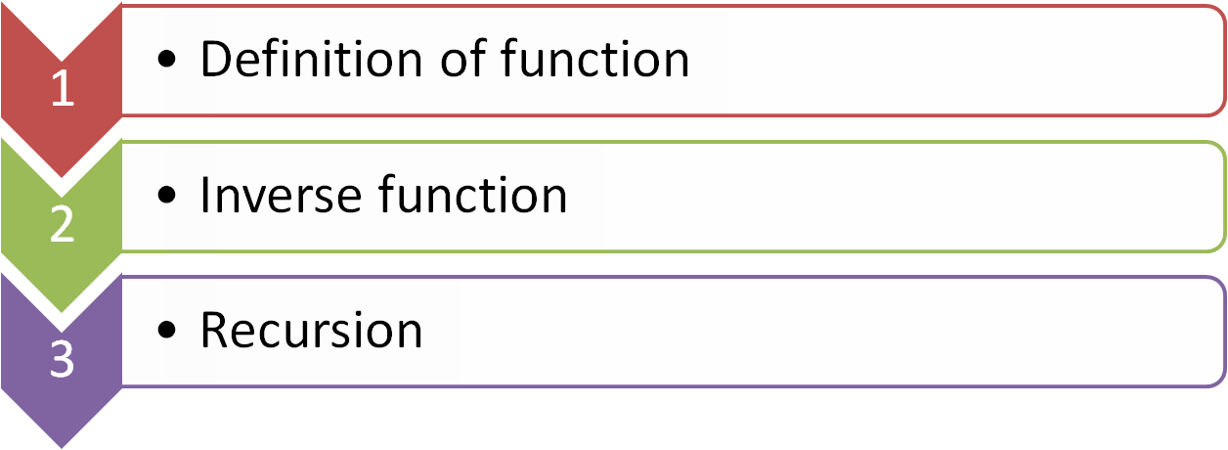


Outline
Definition of fuzzy set
  Properties of fuzzy set

Slide 6
DEFINITION

Slide 7
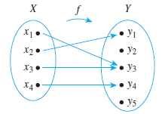
Function
Definition
A function f from a set X to a set Y is a relation between elements of X, called inputs, and elements of Y, called outputs, with the property that each input is related to one and only one output.
The notation f: X → Y means that f
is a function from X to Y, X is called
the domain of f, and Y is called the
co-domain of f.

Slide 8
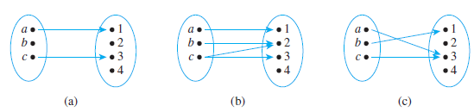
Functions and Non functions
(a). It is not a function because there is an element of X, namely b, that is not sent to any element of F; that is, there is no arrow coming out of b
(b). It is not a function because the element c is not sent to a unique element of Y; that is, there are two arrows coming out of c, one pointing to 2 and the other to 3.
(c). It is a function.

Slide 9
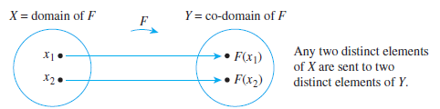
One-to-One Functions
Let F be a function from a set X to a set Y. F is one-to-one (or injective) if, only if, for all elements x₁ and x₂ in X,
if F(x₁) = F(x₂) then x₁ = x₂
Or, equivalently,
if x₁ ≠ x₂ then F(x₁) ≠ F(x₂)

Slide 10
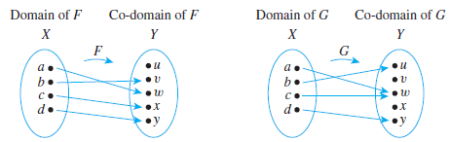
One-to-One Functions
F is one-to-one but G is not.
F is one-to-one because no two different elements of X are sent by F to the same element of Y. G is not one-to-one because the elements a and c are both sent by G to the same element of Y: G(a) = G(c) = w but a ≠ c.
.

Slide 11
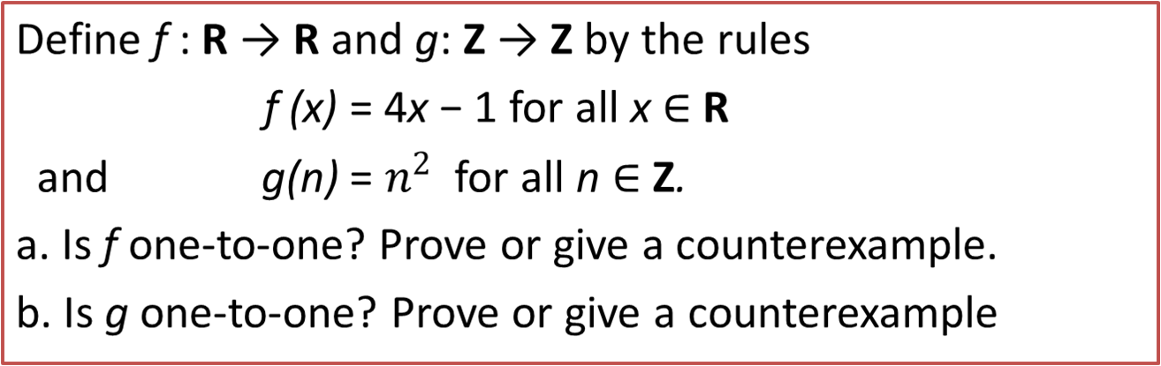
One-to-One Functions on Infinite Sets (1/3)

Slide 12
One-to-One Functions on Infinite Sets (2/3)
a. Suppose x1 and x2 are real numbers such that
f (x1) = f (x2).
[We must show that x1 = x2.] By definition of f ,
4x1 − 1 = 4x2 − 1.
Adding 1 to both sides gives
4x1 = 4x2,
and dividing both sides by 4 gives
x1 = x2,
which is what was to be shown.

Slide 13
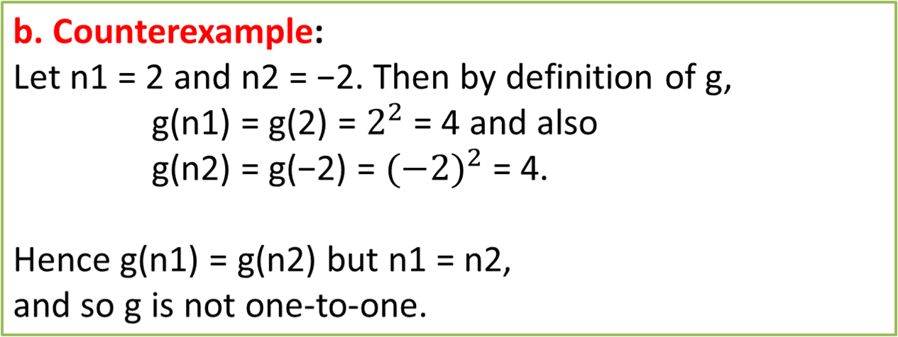
One-to-One Functions on Infinite Sets (3/3)

Slide 14
Onto Functions
Let F be a function from a set X to a set Y. F is onto (or surjective) if, and only if, given any element y in Y, it is possible to find an element x in X with the property that y = F(x).
Symbolically:
F: x→Y is onto ↔ ∀y∈Y, ∃x∈X such that F(x) = y
.

Slide 15
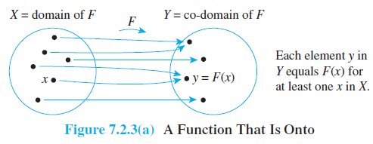
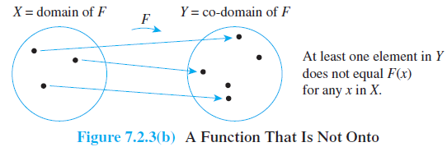
Onto Function

Slide 16
Example : Onto Function on infinite series
Define f : R → R and h: Z → Z by the rules
f (x) = 4x − 1 for all x ∈ R
and
h(n) = 4n − 1 for all n ∈ Z.
a. Is f onto? Prove or give a counterexample.
b. Is h onto? Prove or give a counterexample

Slide 17
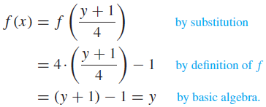
Example : Onto Functions on Infinite Sets
Solution : a. Let y ∈ R. [We must show that ∃x in R such that f (x) = y.] Let x = (y + 1)/4. Then x is a real number since sums and quotients (other than by 0) of real numbers are real numbers. It follows that
[This is what was to be shown.]

Slide 18

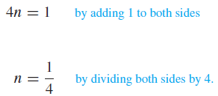
Example : Onto Functions on Infinite Sets
b. Counterexample:
The co-domain of h is Z and 0 ∈ Z. But h(n) ≠ 0 for any integer n. For if h(n) = 0, then
which implies that
And so
But 1/4 is not an integer. Hence there is no integer n for which f (n) = 0, and thus f is not onto.

Slide 19
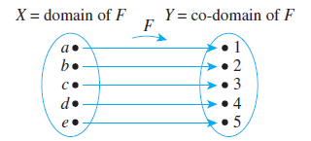
One-to-One Correspondences
A one-to-one correspondence (or bijection) from a set X to a set Y is a function
F: X → Y that is both one-to-one and onto.
.

Slide 20
INVERS FUNCTION

Slide 21
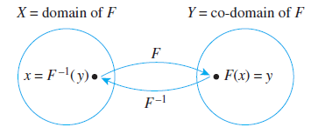
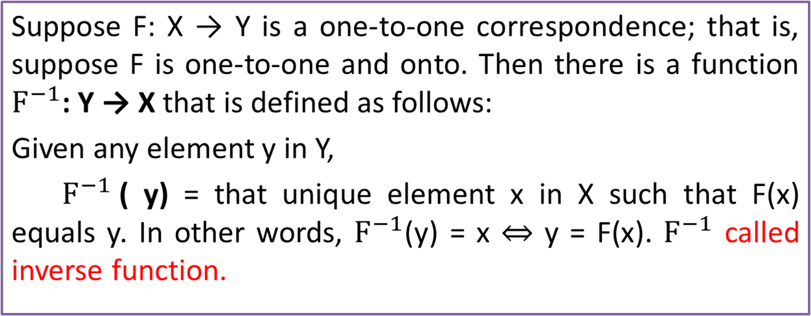
Inverse Functions

Slide 22
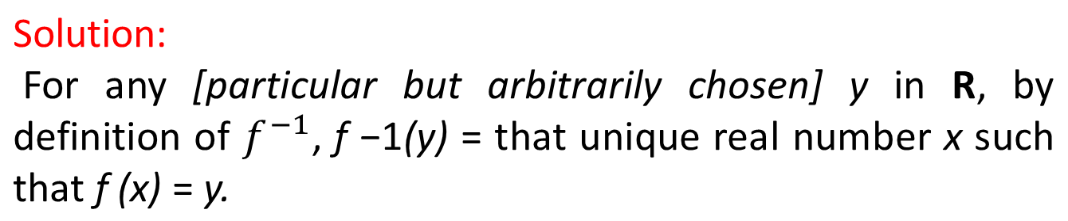
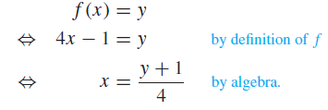

Example: Finding
an Inverse Function
The function f : R → R defined by the formula f (x) = 4x − 1 for all real numbers x. Find its inverse function.
Hence

Slide 23
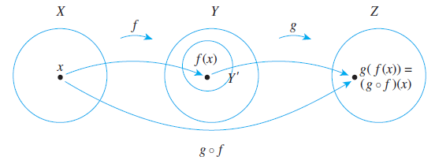
Composition of Functions
Definition:
Let f : X → Y$ and g: Y → Z be functions with the property that the range of f is a subset of the domain of g. Define a new function g ◦ f : X → Z as follows:
(g ◦ f )(x) = g( f (x)) for all x ∈ X,
where g ◦ f is read “g circle f ” and g( f (x)) is read “g of f of x.” The function g ◦ f is called the composition of f and g.

Slide 24
Example : Composition of Functions
Definition:
Let f : Z → Z be the successor function and let g: Z → Z be the squaring function. Then
f (n)=n + 1 for all n ∈ Z and g(n) = n2 for all n ∈ Z.
a. Find the compositions g ◦ f and f ◦g.
b. Is g ◦ f = f ◦g? Explain.
Solution :
a. The functions g ◦ f and f ◦g are defined as follows:
(g ◦ f )(n) = g( f (n)) = g(n + 1) = (n + 1)2 for all n ∈ Z,
and
( f ◦g)(n) = f (g(n)) = f (n2) = n2 + 1 for all n ∈ Z.

Slide 25
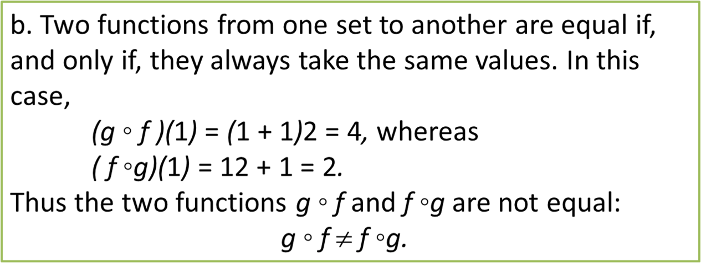
Example : Composition of Functions

Slide 26
RECURSION

Slide 27
Recursively Defined
Sequences
Often it is difficult to express the members of an object or numerical sequence explicitly.
Example:
The Fibonacci sequence: {f_{n} } = 0,1,1,2,3,5,8,13,21,34,…
There may, however, be some “local” connections that can give rise to a recursive definition – a formula that expresses higher terms in the sequence, in terms of lower terms.
Example:
Recursive definition for {f_{n} }:
INITIALIZATION: f₀ = 0, f₁ = 1
RECURSION: f_{n} = f_{n-1}+f_{n-2} for n > 1.
.

Slide 28
Recursive Definitions
and Induction
Recursive definition and inductive proofs are complement each other:
a recursive definition usually gives rise to natural proofs involving the recursively defined sequence.
This is follows from the format of a recursive definition as consisting of two parts:
Initialization –analogous to induction base cases
Recursion –analogous to induction step
In both induction and recursion, the domino analogy is useful.
.

Slide 29
Recursive Factorial Function
A simple example of a recursively defined function is the factorial function:
n! = 1· 2· 3· 4 ···(n –2)·(n –1)·n
INITIALIZATION : 0!= 1
RECURSION : n != n · (n -1)!
To compute the value of a recursive function, e.g. 5!, one plugs into the recursive definition obtaining expressions involving lower and lower values of the function, until arriving at the base case.
Example: 5! = 5 · 4! = 5 · 4 · 3! = 5 · 4 · 3 · 2!
= 5 · 4 · 3 · 2 · 1! = 5 · 4 · 3 · 2 · 1 · 0!
= 5 · 4 · 3 · 2 · 1 · 1 = 120
.

Slide 30
Recursive Algorithms
Fibonacci
integer f (non-negative integer n){
if (n ≤ 1) return n
return f (n -1) + f (n -2)
}
This is an O(2^{n} ) algorithm because going from n to n-1 spawns off 2 method calls, and each of these, in turn, spawns 2 threads, and so on.

Slide 31
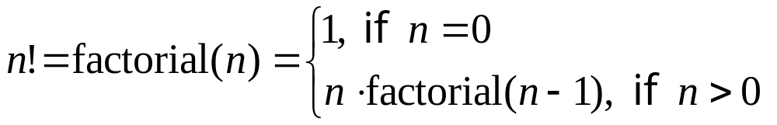
Recursive Algorithms
Factorial
We can immediately convert the definition
into code:
long factorial(int n){
if (n<=0) return 1;
return n*factorial(n-1);
}
.

Slide 32
DEFINITION OF FUZZY SET

Slide 33
Fuzzy Set
Fuzzy Set Theory was formalized by Professor Lofti Zadeh at the University of California in 1965. What Zadeh proposed is very much a paradigm shift that first gained acceptance in the Far East and its successful application has ensured its adoption around the world.

Slide 34
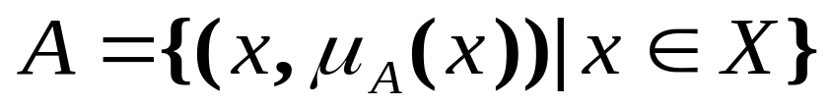
Fuzzy Sets
Formal definition:
A fuzzy set A in X is expressed as a set of ordered pairs:
Crisp set A
Fuzzy set A
1.0
1.0
.9
.5
5’10’’
Heights
5’10’’
6’2’’
Heights
Notes:
115/11/08
A fuzzy set is a set with fuzzy boundary. Suppose that A is the set of tall people. In a conventional set, or crisp set, an element is either belong to not belong to a set; there nothing in between. Therefore to define a crisp set A, we need to find a number, say, 5??, such that for a person taller than this number, he or she is in the set of tall people. For a fuzzy version of set A, we allow the degree of belonging to vary between 0 and 1. Therefore for a person with height 5??, we can say that he or she is tall to the degree of 0.5. And for a 6-foot-high person, he or she is tall to the degree of .9. So everything is a matter of degree in fuzzy sets. If we plot the degree of belonging w.r.t. heights, the curve is called a membership function. Because of its smooth transition, a fuzzy set is a better representation of our mental model of all? Moreover, if a fuzzy set has a step-function-like membership function, it reduces to the common crisp set.

Slide 35
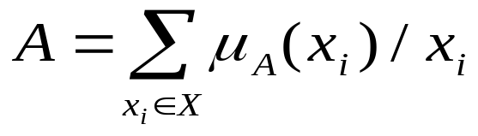
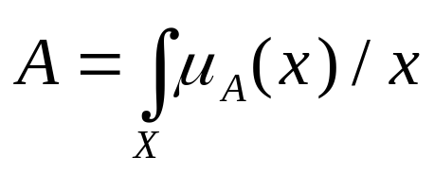
Alternative Notation
A fuzzy set A can be alternatively denoted as follows:
X is discrete
X is continuous
Note that S and integral signs stand for the union of membership grades; “/” stands for a marker and does not imply division.

Slide 36
PROPERTIES FUZZY SET

Slide 37
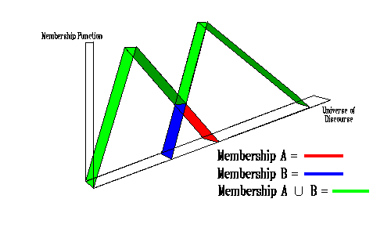
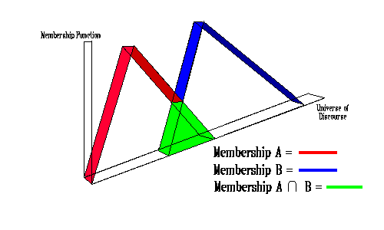
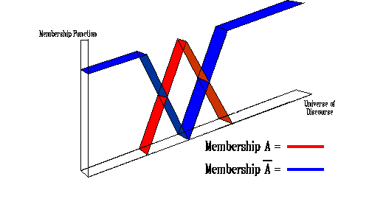
Operations of Fuzzy Set (1/2)
Union :
μ_{A∪B}(x) = max(μ_{A}(x),μ_{B}(x))
Intersection:
μ_{A∩B}(x) = min(μ_{A}(x),μ_{B}(x))
Complement:
μ_{not A}(x) = 1-μ_{A}(x))

Slide 38
Operations of Fuzzy Set (2/2)
Fuzzy set A is equal to fuzzy set B if
Fuzzy set A is subset of fuzzy set B

Slide 39

Support
The support of a fuzzy set A in the universe of discourse U is a crisp set that contains all the elements of U that have nonzero membership values in A
If the support of a fuzzy set is empty it is called and empty fuzzy set

Slide 40

Alpha - Cut
An α-cut of a fuzzy set A is a crisp set Aα that contains all the elements in U that have membership values in A greater than or equal to α

Slide 41
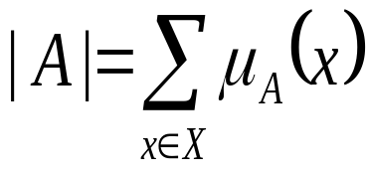
Cardinality
A fuzzy set A in X has cardinality

Slide 42




Example: Discrete
Fuzzy Set (1/2)
(usia)
x
(x)
(x)
(x)
(x)
5
0
0
1
0
10
0
0
1
0
20
0
0,8
0,8
0,1
30
0
1
0,5
0,2
40
0
1
0,2
0,4
50
0
1
0,1
0,6
60
0
1
0
0,8
70
0
1
0
1
80
0
1
0
1

Slide 43
Example: Discrete
Fuzzy Set (2/2)
supp Tua = {20,30,40,50,60,70,80}
Muda _{0,2} = {5,10,20,30,40}
Muda _{0,8} = {5,10,20}
Muda₁ = {5,10}
|Bayi| = 0
Muda U Tua = 1/5+1/10+0,8/20+0,5/30+0,4/40
+0,6/50+0,8/60+1/70+1/80.
Muda ∩ Tua = 0,1/20+0,2/30+0,2/40+0,1/50

Slide 44
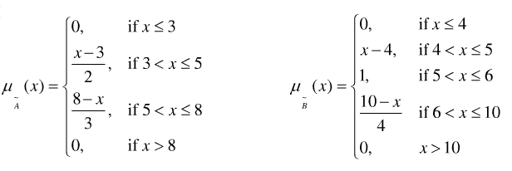
Example: Continuous
Fuzzy Set (1/4)
Giving two fuzzy utilities expressed in
Draw their figures
Draw A∩B, A∪B, A^{c}, B^{c}, A^{c}∪B^{c},A^{c}∩B^{c} and support of them

Slide 45
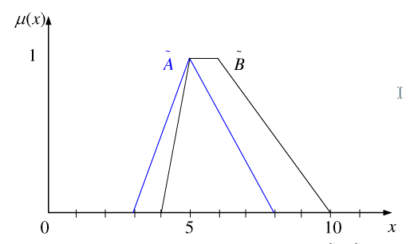
Example: Continuous
Fuzzy Set (2/4)
Supp (A∩B) = 4 < x ≤ 8
A∩B
Supp (A) = 3 < x ≤ 8
Supp (B) = 4 < x ≤ 10

Slide 46
Example: Continuous
Fuzzy Set (3/4)
Supp (A∪B) = 3 < x ≤ 10
A^{c}
B^{c}
A∪B
Supp (A^{c}) = x ≠ 5
Supp (B^{c}) = x < 5, x > 6

Slide 47
Example: Continuous
Fuzzy Set (4/4)
Supp (A^{c}∪B^{c}) = x ≠ 5
1
A^{c}∩B^{c}
A^{c}
B^{c}
1
A^{c}∪B^{c}
0
5
10
A^{c}
B^{c}
Supp (A^{c}∩B^{c}) = x < 5, x > 6
0
5
10

Slide 48
Reference
Susanna S.Epp. (2015). Discrete Mathematics with Applications.5th edition. Thomson Brooks/Cole. USA. ISBN: 9780534359454

